Slide 1
Neural Networks and Backpropagation

Slide 2
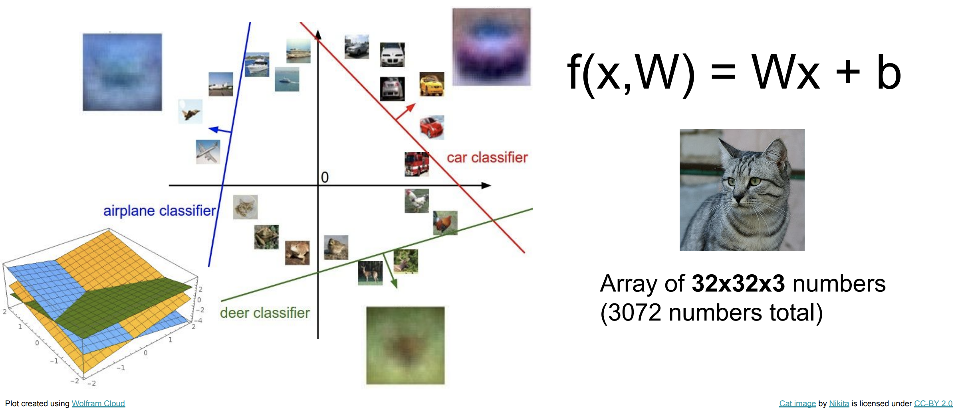
Review: Linear Classification

Slide 3
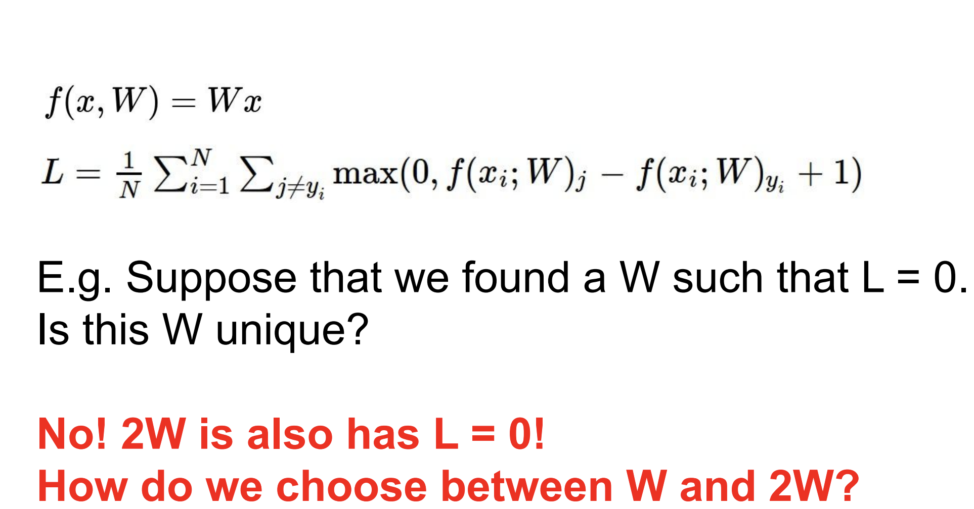
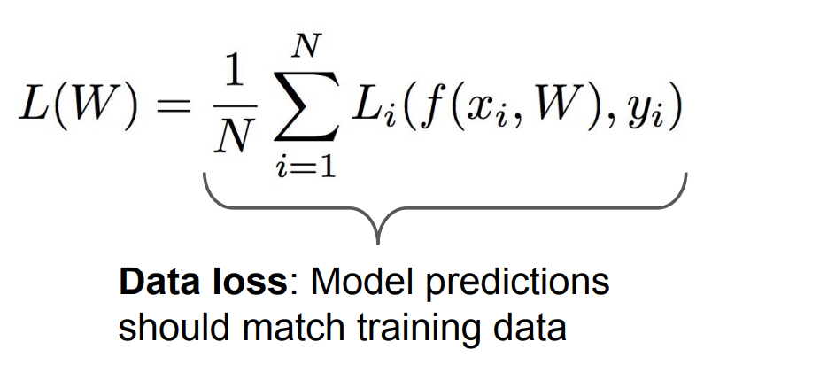
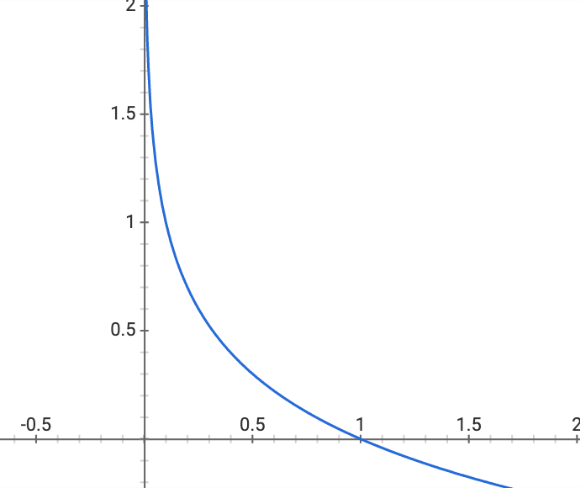
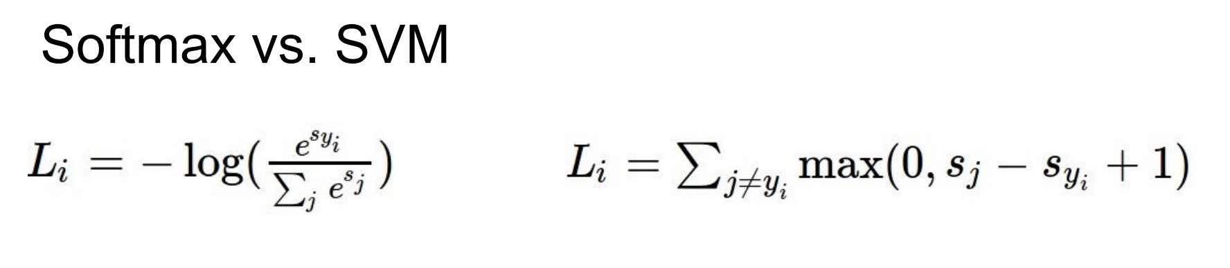
Review: Linear Classification

Slide 4
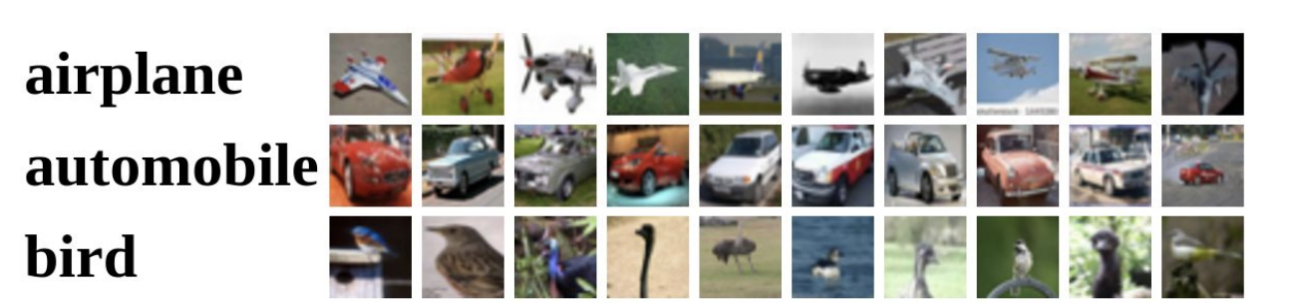
Optimization
W ?

Slide 5
Back propagation

Slide 6
What is gradient descent algorithm??
Back propagation calculates the gradient of the error of the network regarding the network's modifiable weights.
This gradient is almost always used in a simple stochastic gradient descent algorithm to find weights that minimize the error.
E(W)
w₂
w₁

Slide 7
Computation of SVM

Slide 8
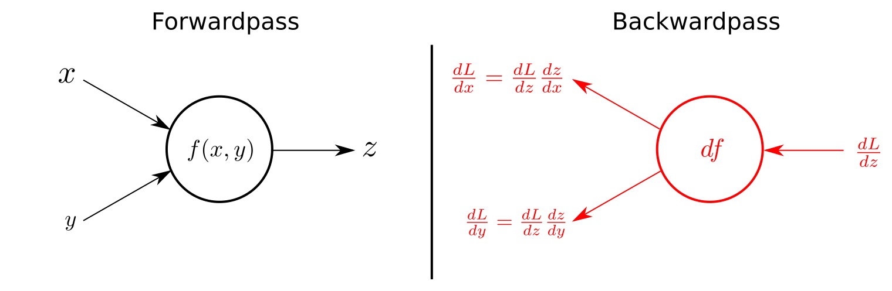
Forwardpass and Backwardpass

Slide 9
Backpropagation: a simple example

Slide 10
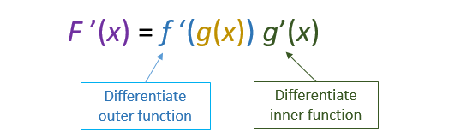
Backpropagation: a simple example

Slide 11
Backpropagation: a simple example

Slide 12
Backpropagation: a simple example

Slide 13
Backpropagation: a simple example

Slide 14
Backpropagation: a simple example

Slide 15
Backpropagation: a simple example

Slide 16
Backpropagation: a simple example

Slide 17
Backpropagation: a simple example

Slide 18
Backpropagation: a simple example

Slide 19
Backpropagation: a simple example

Slide 20
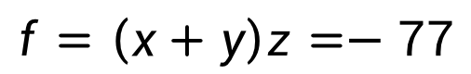
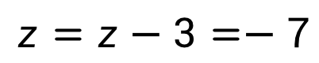
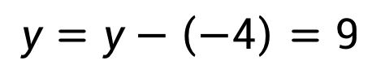
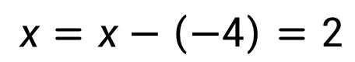
Backpropagation: a simple example
$$x=x−\left(−4\right)=2$$
$$f=\left(x+y\right)z=−77$$
$$y=y−\left(−4\right)=9$$
$$z=z−3=−7$$

Slide 21
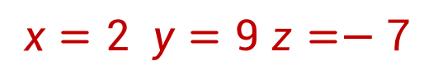
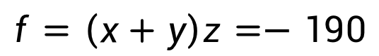
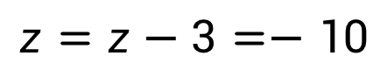
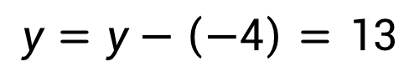
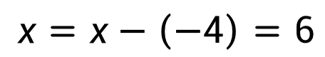
Backpropagation: a simple example
$$x=2 y=9 z=−7$$
$$x=x−\left(−4\right)=6$$
$$f=\left(x+y\right)z=−190$$
$$y=y−\left(−4\right)=13$$
$$z=z−3=−10$$

Slide 22
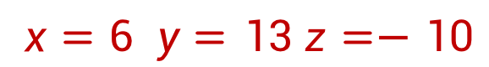
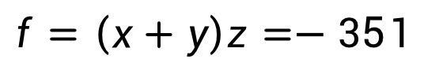
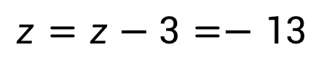
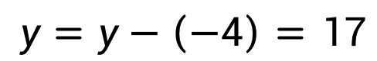
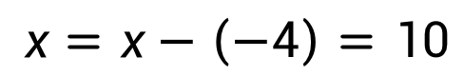
Backpropagation: a simple example
$$x=6 y=13 z=−10$$
$$x=x−\left(−4\right)=10$$
$$f=\left(x+y\right)z=−351$$
$$y=y−\left(−4\right)=17$$
$$z=z−3=−13$$

Slide 23
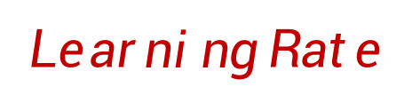
Backpropagation: a simple example
$$Learning Rate$$

Slide 24
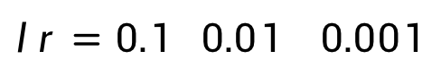
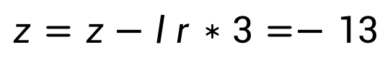
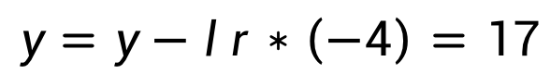
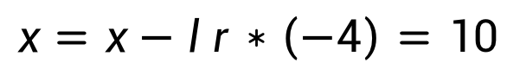
Backpropagation: a simple example
$$x=6 y=13 z=−10$$
$$x=x−lr∗\left(−4\right)=10$$
$$lr=0.1 0.01 0.001$$
$$y=y−lr∗\left(−4\right)=17$$
$$z=z−lr∗3=−13$$

Slide 25
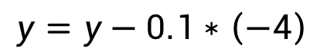
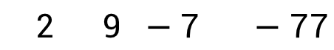
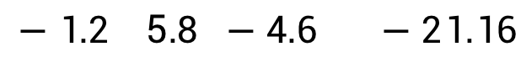
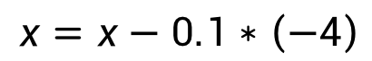
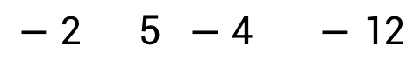
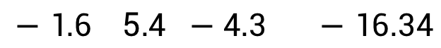
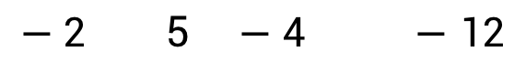
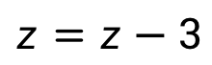
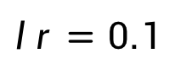
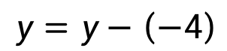
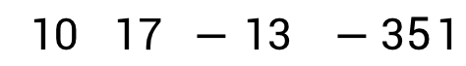
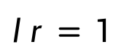
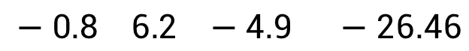
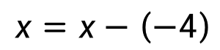
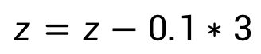
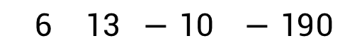
Backpropagation: a simple example
$$lr=1$$
$$lr=0.1$$
$$x=x−\left(−4\right)$$
$$x=x−0.1∗\left(−4\right)$$
$$y=y−\left(−4\right)$$
$$y=y−0.1∗\left(−4\right)$$
$$z=z−3$$
$$z=z−0.1∗3$$
$$x y z f x y z f$$
Iter1:
$$−2 5 −4 −12$$
$$−2 5 −4 −12$$
Iter2:
$$2 9 −7 −77$$
$$−1.6 5.4 −4.3 −16.34$$
Iter3:
$$6 13 −10 −190$$
$$−1.2 5.8 −4.6 −21.16$$
Iter4:
$$10 17 −13 −351$$
$$−0.8 6.2 −4.9 −26.46$$

Slide 26
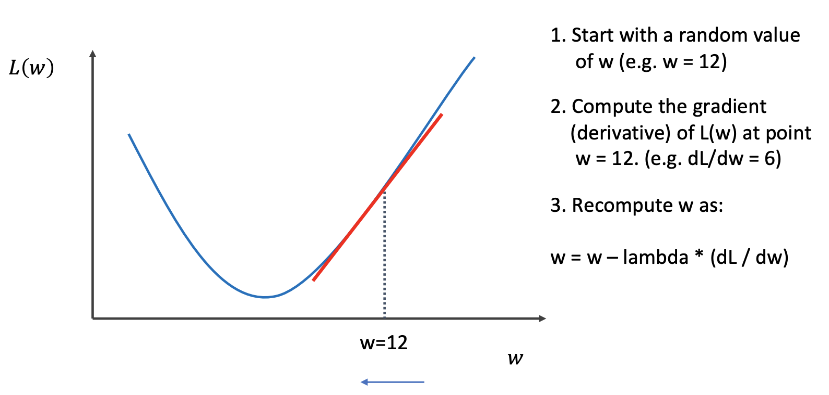
Gradient Descent

Slide 27
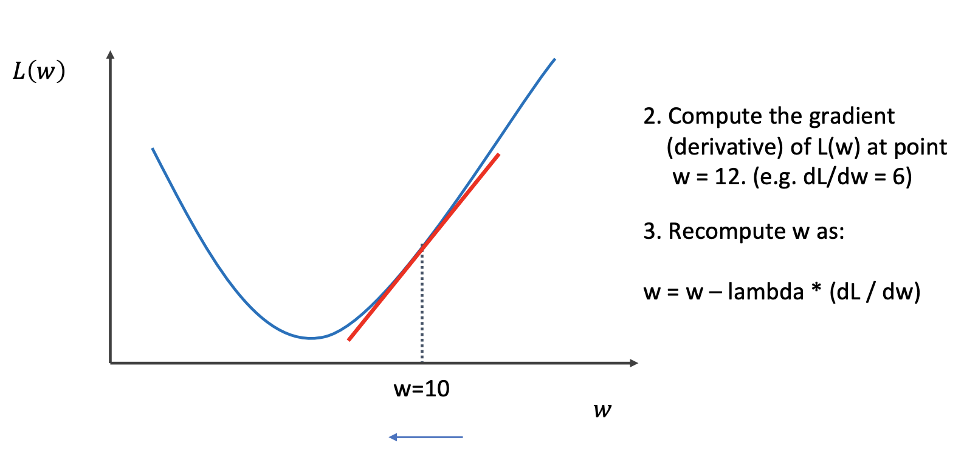
Gradient Descent

Slide 28
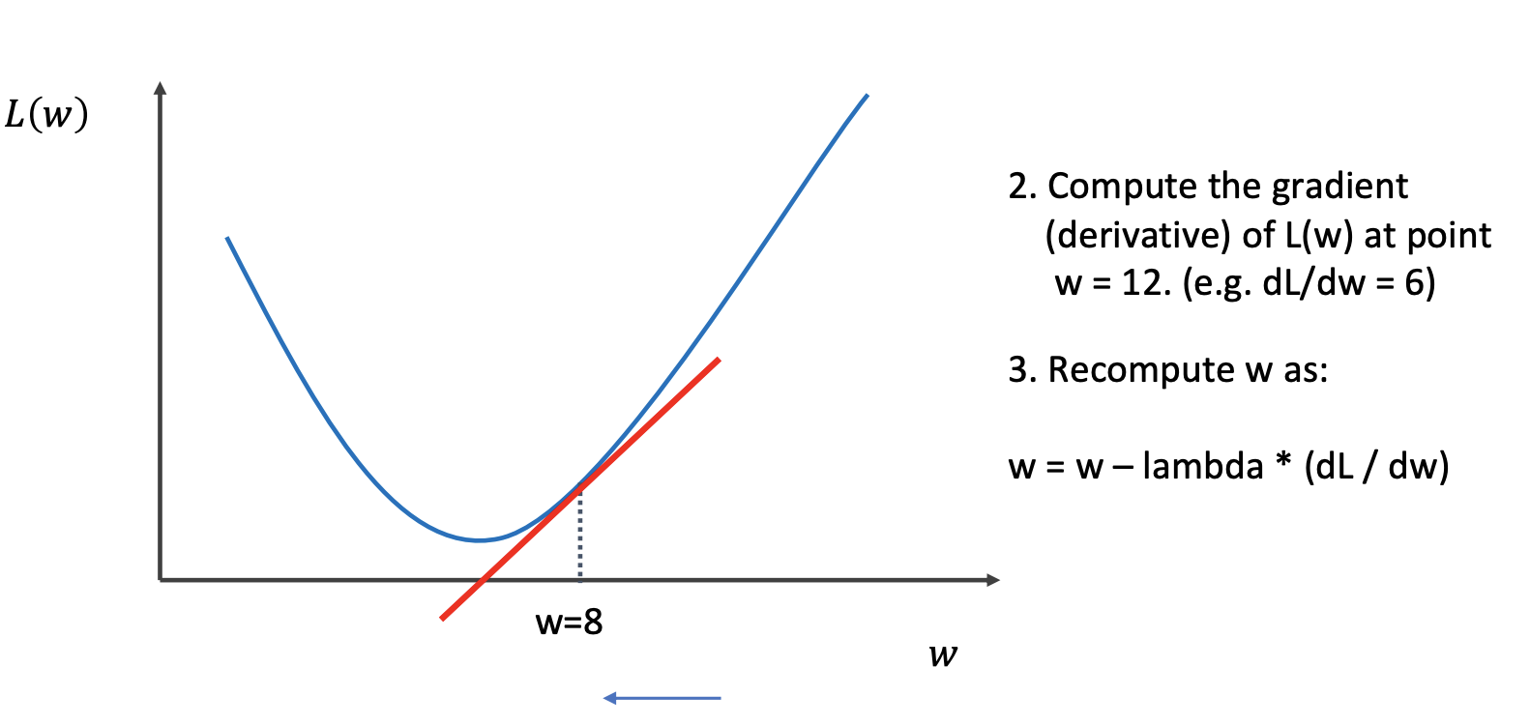
Gradient Descent

Slide 29
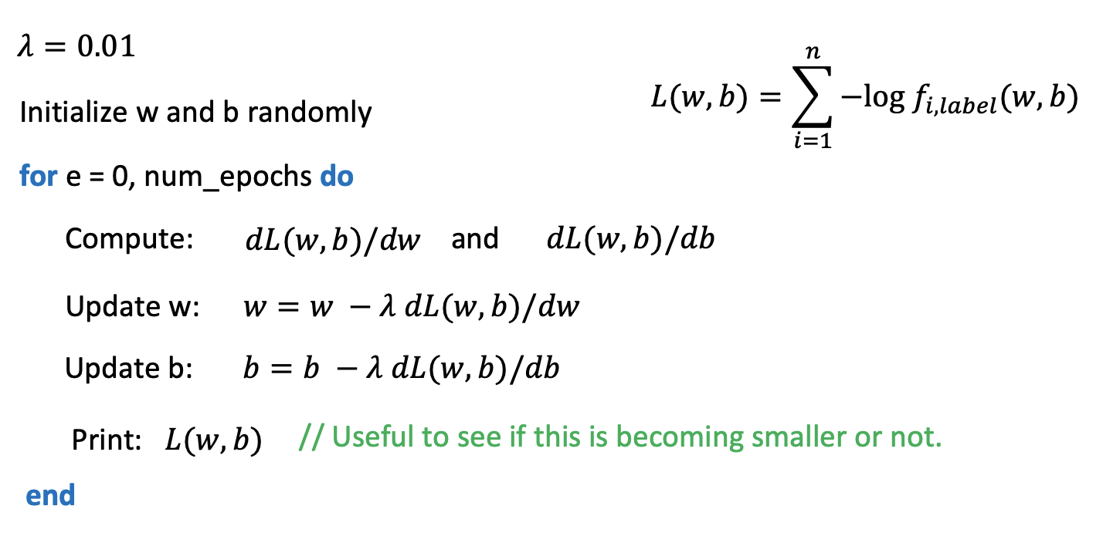
Gradient Descent

Slide 30
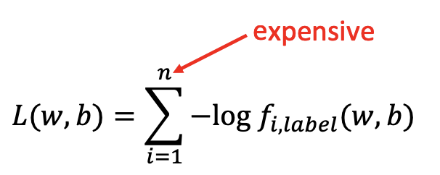
Gradient Descent

Slide 31
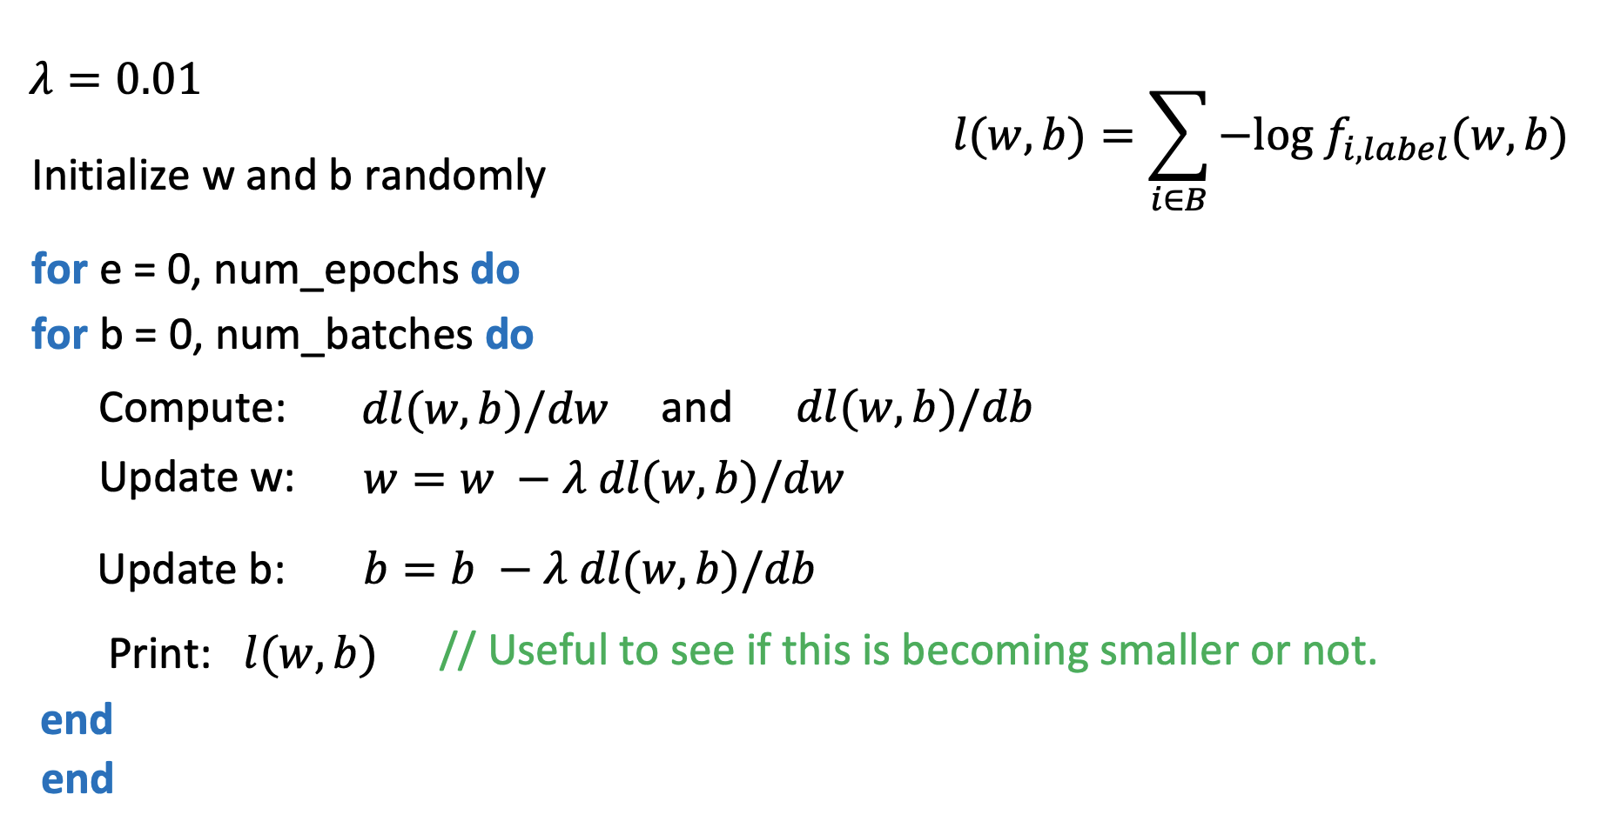
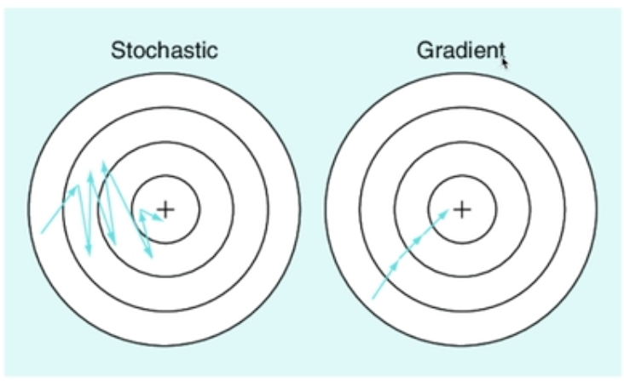
(mini-batch) Stochastic Gradient Descent

Slide 32


(mini-batch) Stochastic Gradient Descent

Slide 33
(mini-batch) Stochastic Gradient Descent

Slide 34
Backpropagation: another example

Slide 35
Backpropagation: another example

Slide 36
Backpropagation: another example

Slide 37
Backpropagation: another example

Slide 38
Backpropagation: another example

Slide 39
Backpropagation: another example

Slide 40
Backpropagation: another example

Slide 41
Backpropagation: another example

Slide 42
Backpropagation: another example

Slide 43
Backpropagation: another example

Slide 44
Backpropagation: another example

Slide 45
Backpropagation: another example

Slide 46
Backpropagation: another example

Slide 47
Backpropagation: another example

Slide 48
Backpropagation: a simple example

Slide 49
Backpropagation: a simple example

Slide 50
Backpropagation: a simple example

Slide 51
Backpropagation: a simple example

Slide 52
Backpropagation: a simple example
Notes:
out = forward(in)
din = backward(dout, in)
Local gradient is a function of in, so backward also take in as input
Can we obtain gradients without forward? No

Slide 53
Neural Networks

Slide 54
Now neural networks

Slide 55
Now neural networks

Slide 56
Now neural networks

Slide 57
Now neural networks

Slide 58
Neural network architectures

Slide 59
Feed-forward computation

Slide 60
Activation functions
The gates that decide whether or not messages will be passed through a neuron. Without activations, neural networks are just linear transformations

Slide 61
Activation functions

Slide 62
Sigmoid

Slide 63
Sigmoid
Notes:
Firing rate

Slide 64
Sigmoid

Slide 65
Sigmoid

Slide 66
Sigmoid
Notes:
dL/dw = dL/dp * dp/dw = dL/dp * x’,
where p = w’x + b
Note x is the output of the previous activation function

Slide 67
Sigmoid
Notes:
How to implement exp(): use 泰勒展开

Slide 68
Tanh
Used to be very popular in sequence modeling (e.g., LSTM/GRU)

Slide 69
ReLU
[Nair & Hinton, 2010]

Slide 70
ReLU
Two weakness:
Non-smooth point at x=0 (why ELU and GELU is proposed)
Saturate for x<0 (why LReLU and maxout is proposed)

Slide 71
ReLU

Slide 72
ReLU
Notes:
假设
绿色箭头所在halfspace表示w1’x + b1 > 0的区域
红色箭头所在halfspace表示w2’x + b2 > 0的区域
图中data cloud代表训练数据的分布区域
For sigma(w’x+b), where y = w’x + b,
dL/dw = dL/dsigma * dsigma/dy * dy/dw
可见，
还有数据落在y1=w1’x + b1 > 0的区域 → 神经元sigma(y1)的导数还有可能不为0 → 参数w1和b1还有可能被update
没有数据落在y2=w2’x + b2 > 0的区域 → 神经元sigma(y2)的导数只有可能全为0 → 参数w2和b2没有可能被update

Slide 73
ReLU

Slide 74
Leaky ReLU

Slide 75
Maxout “Neuron”

Slide 76
Exponential Linear Units (ELU)

Slide 77


Swish and H-Swish
Swish is automatically searched!
The corresponding paper “SEARCHING FOR ACTIVATION FUNCTIONS” by
P. Ramachandran, B. Zoph, Quoc V. Le is rejected by ICLR18, as reviewers and anonymous ones counter that PRelus should be doing quite well too.
But now it has 900+ citations.

Slide 78

Activation functions in practice
- Replacing ReLU by swish improves performance, at a cost of slower speed
- GELU is widely adopted in NLP (BERT, GPT)
“Although various hand-designed alternatives to ReLU have been proposed, none have managed to replace it due to inconsistent gains.”
In “Searching for Activation Functions”, 2017
Dead neuron will not exist after using batch normalization

Slide 79
What features a good activation should have
Non-linear
Differentiable at almost everywhere
Simple computation
Non-saturation

Slide 80

How to Choose an Output Layer Activation Function

Slide 81


Slide 82


Slide 83


Slide 84


Slide 85


Slide 86


Slide 87


Slide 88


Slide 89


Slide 92


Slide 93


Slide 94


Slide 95
Limitations of the back propagation algorithm
It is not guaranteed to find global minimum of the error function. It may get trapped in a local minima,
Improvements,
Add momentum.
Use stochastic gradient descent.
Use different networks with different initial values for the weights.
Back propagation learning does not require normalization of input vectors; however, normalization could improve performance.
Standardize all features previous to training.

